Slide 1


Malattie reumatologiche croniche infiammatorie (CIRDs) e rischio CV
A problem
A challenge
An opportunity
Marcello Govoni
gvl@unife.it
Rheumatology Unit
Department of Medical Sciences

Slide 2
Outline
What are we talking about ?
Why CV risk is a problem in CIRDs ?
What is the burden of CV risk factors and CVD in CIRDs ?
Which strategies to prevent CV risk in CIRDs

Slide 3
Chronic Inflammatory Rheumatic Diseases (CIRDs)
What are we talking about ?
Rheumatoid arthritis (RA)
Spondyloarthritis (AS, PsA, uSpA)
Connective tissue disorders (focus on SLE)
Gout

Slide 4
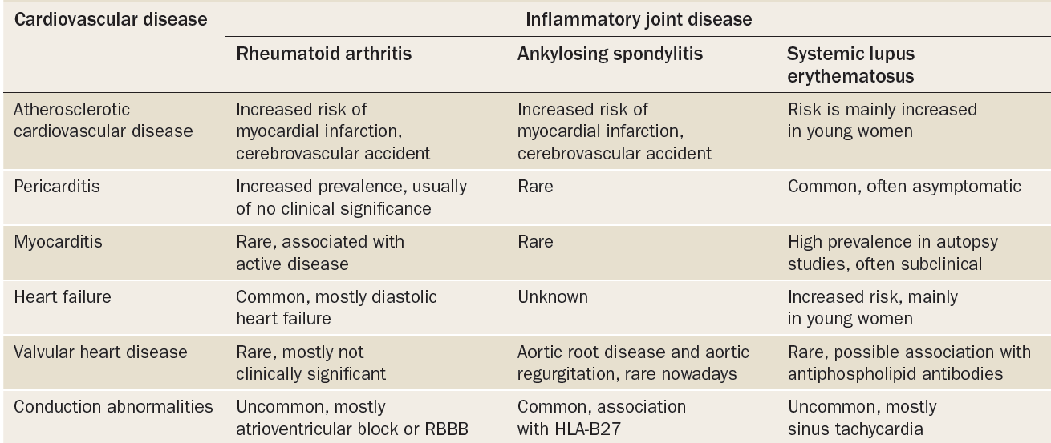
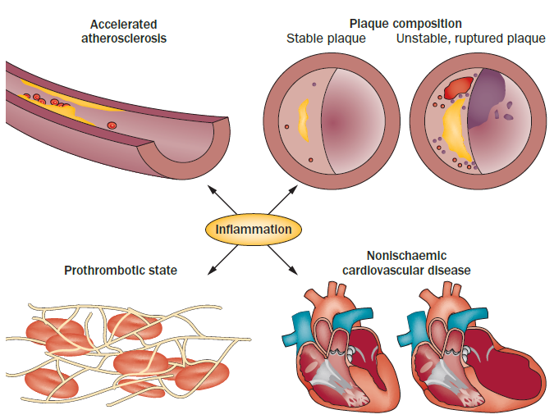
CV involvement in inflammatory rheumatic diseases

Slide 5
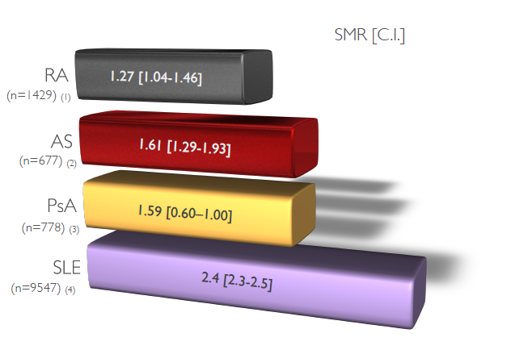
Autoimmune diseases and mortality rates
2. Why CV risk is a problem in CIRDs ?
(vs GP)

Slide 6
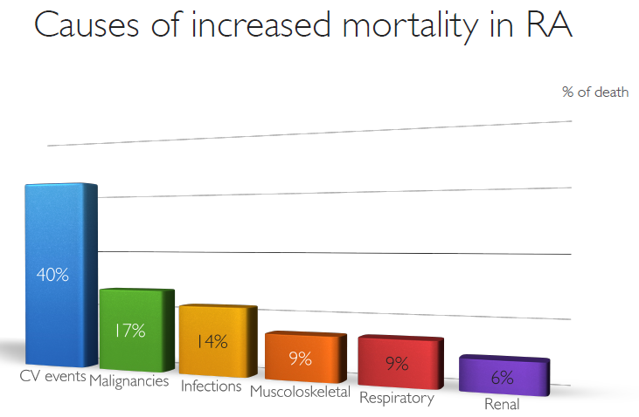

Slide 7
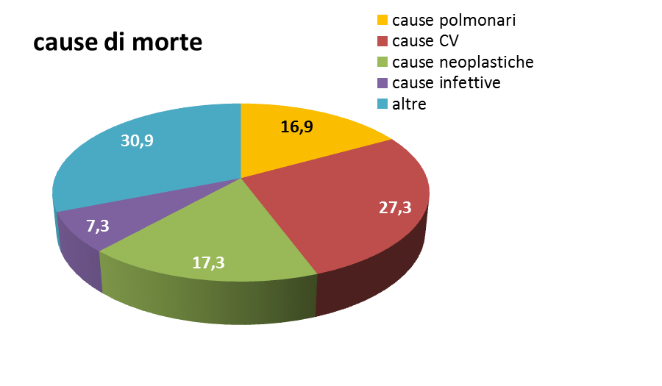
Cause of death in hospitalized RA patients in RER (2000-2015)
Govoni M. 2017 (unpublished)

Slide 8
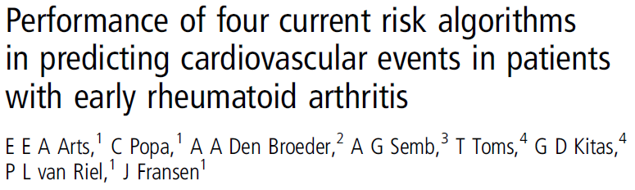
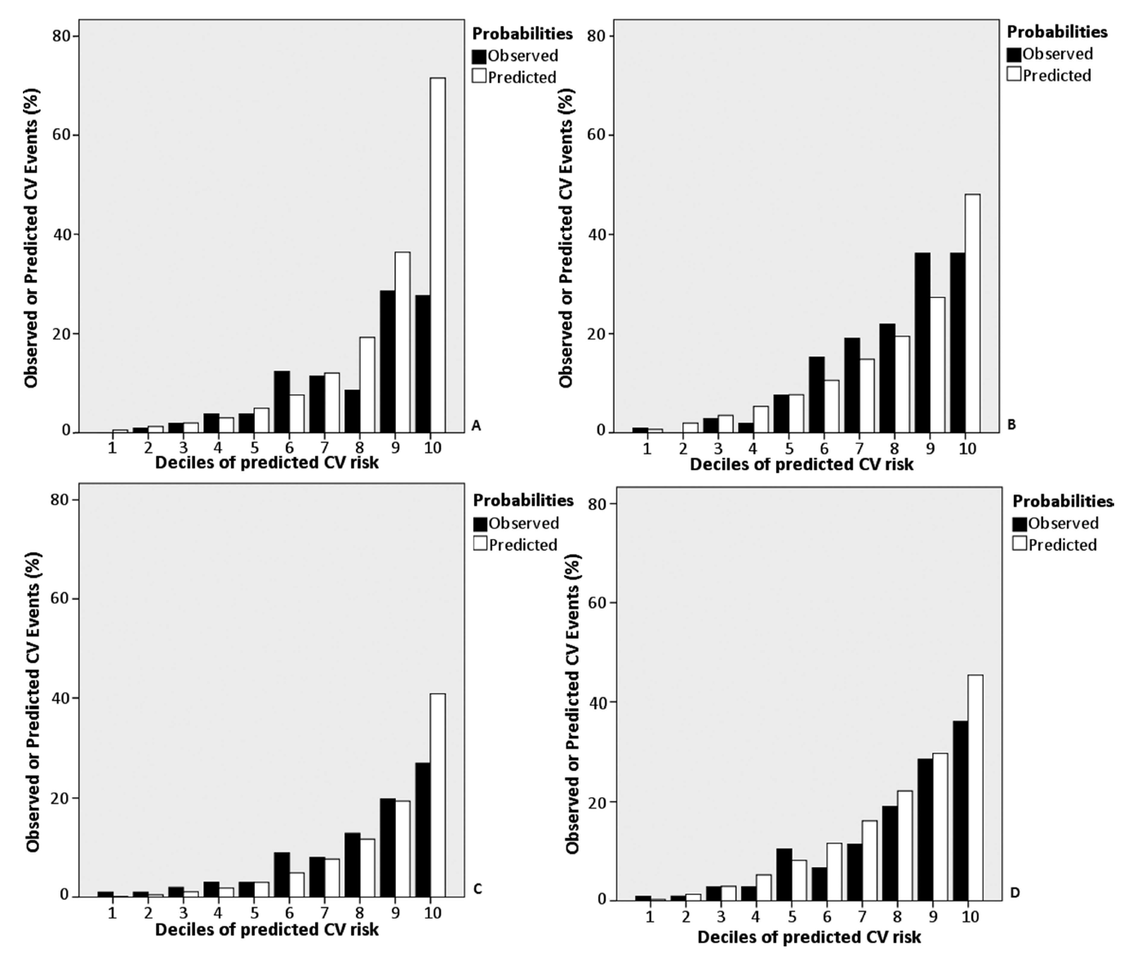
Established risk models generally underestimate CV risk in patients with RA
SCORE
Framingham risk score
Reynolds
QRisk II*
deciles of predicted risk
Overall, the number of CV events that were expected based on the risk calculated by these algorithms appeared to be an inaccurate estimate of the observed number of CV events in patients with RA

Slide 9
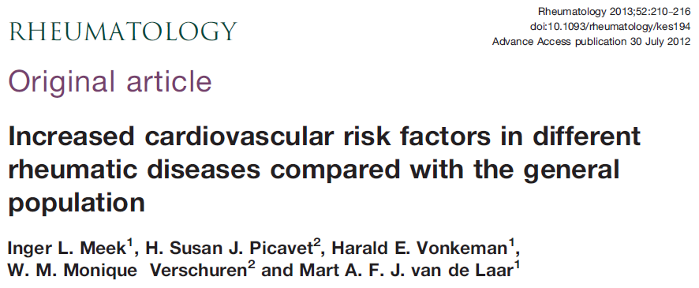
3. What is the burden of CV risk factors and CVD in CIRDs ?
Are CV risk factors increased in CIRDs vs GP ?
Eastern part of the Netherlands
To compare the prevalence of traditional cardiovascular risk factors in different rheumatic diseases with that in the general population.

Slide 10
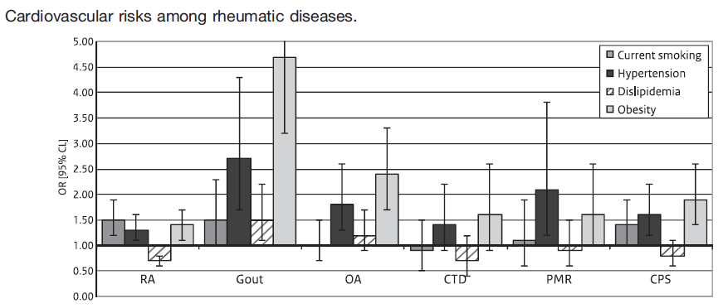
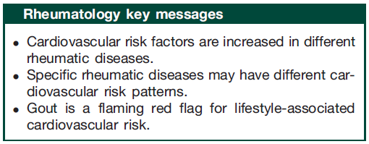
Meek IL et al.
Rheumatology 2013

Slide 11

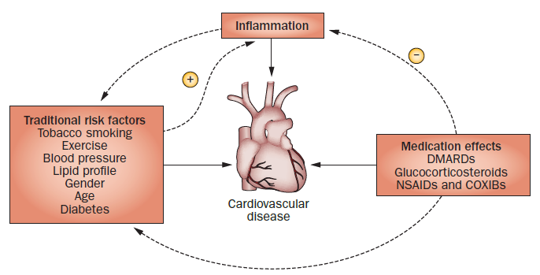
In CIRDs «a dangerous triangle»
Nurmohamed MT et al. Nat Rev Rheumatol 2015

Slide 12
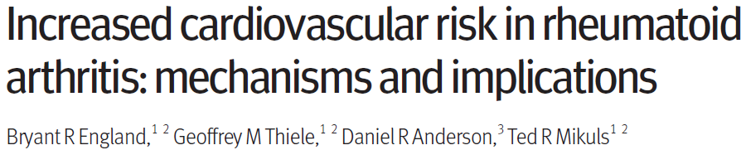
Rheumatoid arthritis

Slide 13
2 meta-analyses
Avina-Zubieta JA et al. Ann Rheum Dis 2012
Aviña- Zubieta JA et al. Arthritis Rheum 2008
150 000 patients
Observational studies
risk of cardiovascular events in RA
most frequent manifestations of cardiovascular disease
RR = 1.48, [95% CI 1.36 to 1.62]
+ 48%
vs GP
cardiovascular disease related mortality in RA
atherosclerosis
congestive heart failure (CHF)
SMR = 1.50 [95% CI 1.39 to 1.61]
+ 50 %
RR : Relative Risk
SMR : Standardized Mortality Ratio

Slide 15
RISK FACTORS
Framingham Risk Score components
  Age
  Sex
  History of diabetes mellitus
  Smoking status
  Systolic blood pressure
  Total cholesterol, HDL cholesterol

Slide 16
ADDITIONAL RISK FACTORS
Lp(a)
Intima media thickness (sonography, Aa. carotides)
  Physical inactivity (aerobic exercise <3 times/week)
  Obesity
  Sodium intake >1.5 g/day
  Psychosocial issues (stress)
  „Abnormal“ alcohol use
  Positive family history for cardiovascular disease

Slide 17
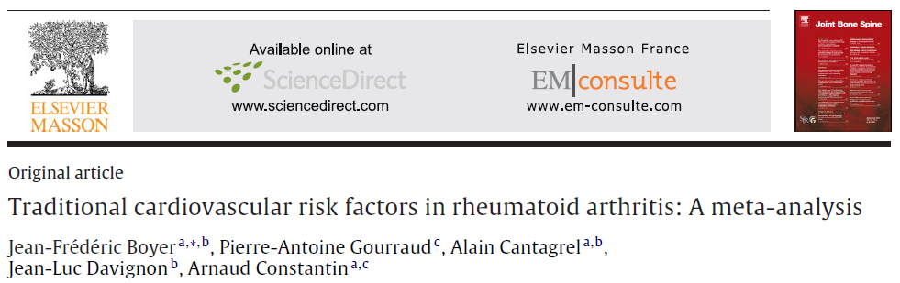
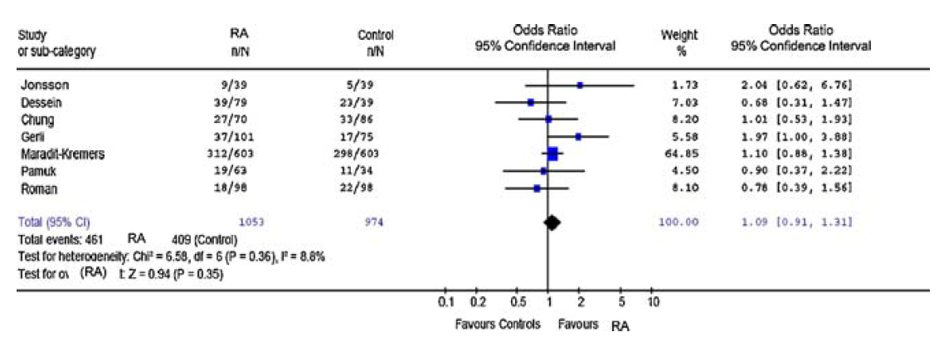
Hypertension
The prevalence of hypertension did not differ vs GP (OR = 1.09 )
Hypertension defined on two or more ambulatory blood pressure readings ≥140 mmHg systolic and/or 90 mmHg diastolic, and/or current treatment with antihypertensive agents
(95 % CI = 0.91 - 1.31 p = 0.35)
RA vs HC = 2956 vs 3713

Slide 18
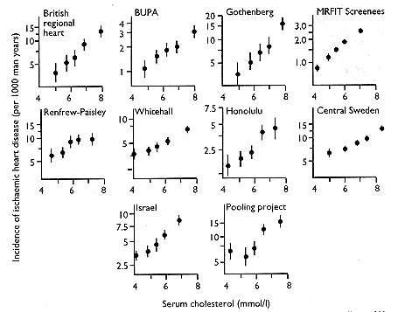
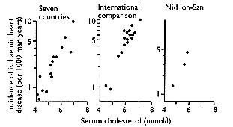
An adverse lipid profile or dyslipidaemia is an important risk factor for cardiovascular disease (CVD) in the general population
Dyslipidaemia
JAMA. 2001; 285(19):2486–97.
Circulation. 2002; 106(25):3143–421
Several studies have reported a continuous increase in cardiovascular risk with increasing serum cholesterol levels
Stamler J et al. JAMA. 2000
Law MR et al. BMJ. 1994

Slide 19
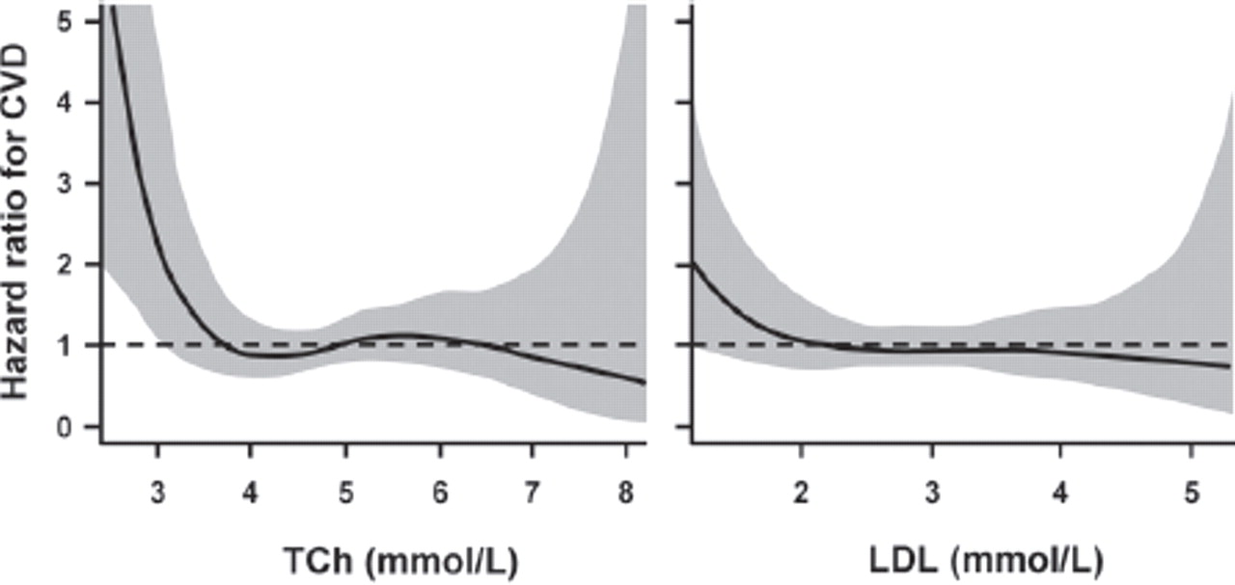

Lipid paradox in RA
HRs for CVD in rheumatoid arthritis (solid lines) according to (A) TCh and (B) LDL. Shaded areas represent 95% CIs. CVD, cardiovascular disease; LDL, low-density lipoprotein cholesterol; TCh, total cholesterol.
Elena Myasoedova et al. Ann Rheum Dis 2011;70:482-487
a population-based incidence cohort of patients with RA
Notes:
HRs for CVD in rheumatoid arthritis (solid lines) according to (A) TCh and (B) LDL. Shaded areas represent 95% CIs. CVD, cardiovascular disease; LDL, low-density lipoprotein cholesterol; TCh, total cholesterol.

Slide 20
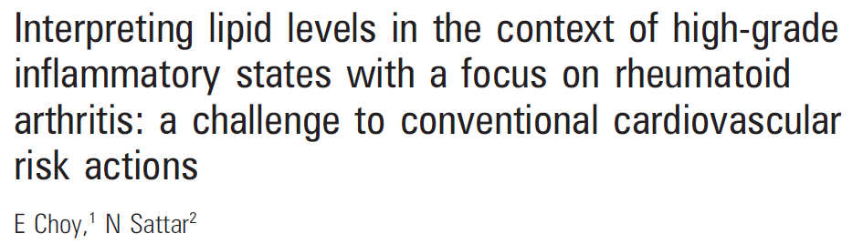
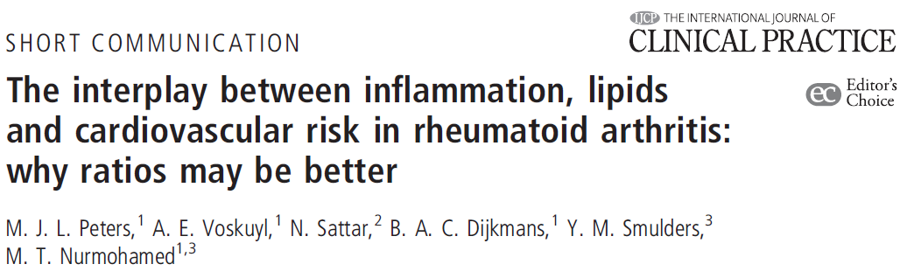
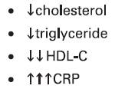
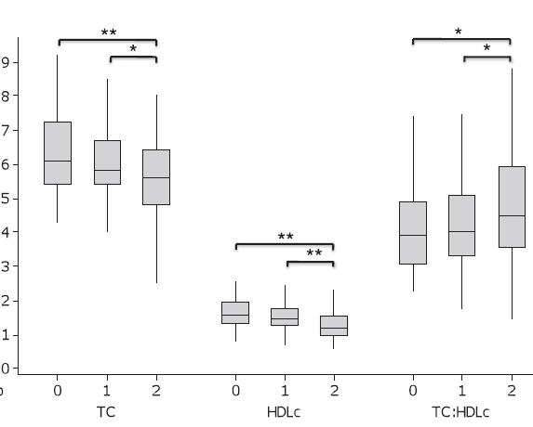
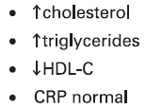
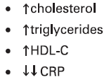
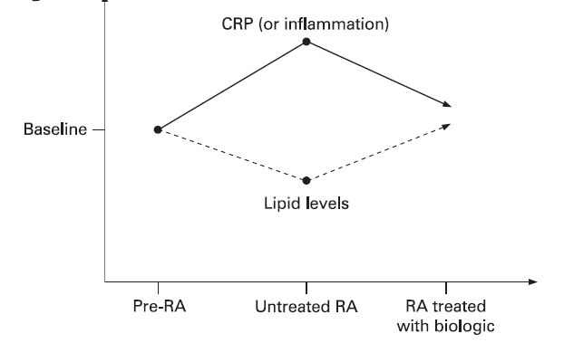
2010
0 = CRP < 3 mg⁄l
1 = CRP 3 – 10 mg/l
2 = CRP > 10 mg/l
Notes:
CRP levels correlate with a
higher TC:HDLc ratio, because the negative gradient
between CRP and HDLc is stronger than the gradient
between CRP and TC.

Slide 21
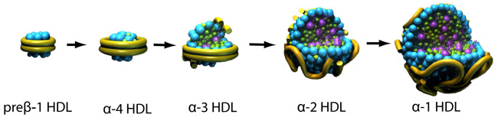
HDL acts as an antioxidant and regulates cholesterol efflux.
Under inflammatory conditions, changes in HDL composition occur and lead to impaired function
HDL from RA patients with high disease activity had reduced cholesterol efflux capacity in vitro
Charles-Schoeman C et al. Ann Rheum Dis 2012

Slide 22
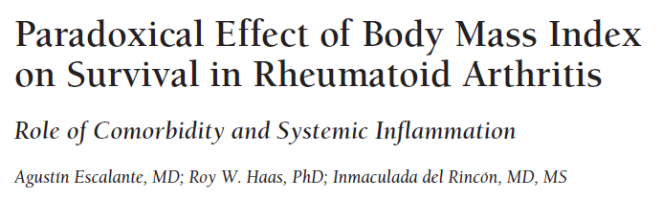
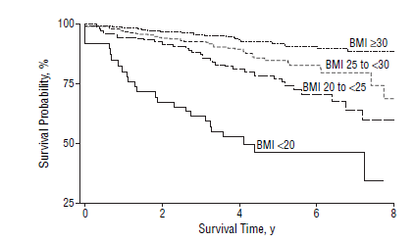
Obesity

Slide 23

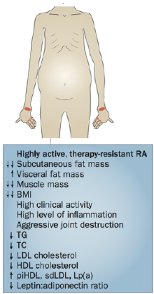
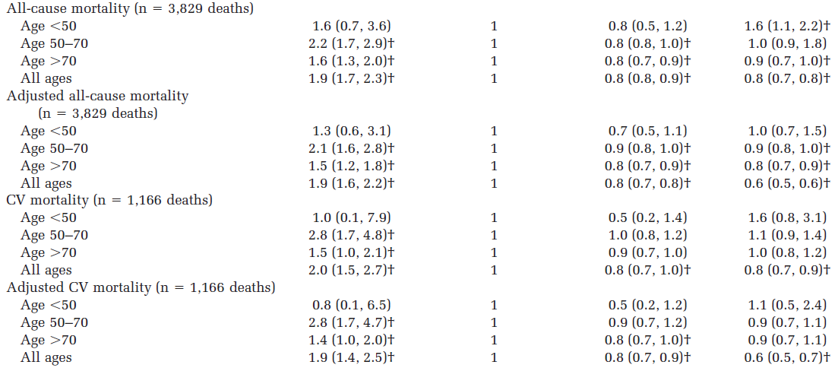
The obesity-mortality paradox in RA
Overweight and obesity reduce the RR of all-cause and CV mortality across different age groups and durations of RA.
Rheumatoid cachexia
*
*
*
adjusted for DM, hypertension, history of MI and current smoking
Notes:
* Values are the relative risk, adjusted for sex (95% confidence interval) unless otherwise indicated. Adjusted body mass index (BMI) category was
adjusted for self-reporting. Adjusted all-cause and cardiovascular (CV) mortality categories were adjusted for diabetes mellitus, hypertension, history
of myocardial infarction, and current smoking.
† Significant at P 0.05.

Slide 24

Mechanisms linking RA and CVD
Traditional CV risk factors
What is clearly acknowledged
smoking has consistently been identified as a robust and shared risk factor for the development of CVD and RA
Are they over represented in RA ?
Sugiyama D et al. Ann Rheum Dis 2010
(metanalysis of OS)
Controversial
YES
Jafri K et al. Arthritis Care Res (Hoboken) 2017
An J et al. J Rheumatol 2016
No
Gonzalez A et al. Ann Rheum Dis 2008
Solomon DH et al. Circulation 2003

Slide 25
Key message
The traditional interpretation of some traditional risk factor for CVD may not apply in RA
and can influence the reliability of current scoring systems

Slide 27

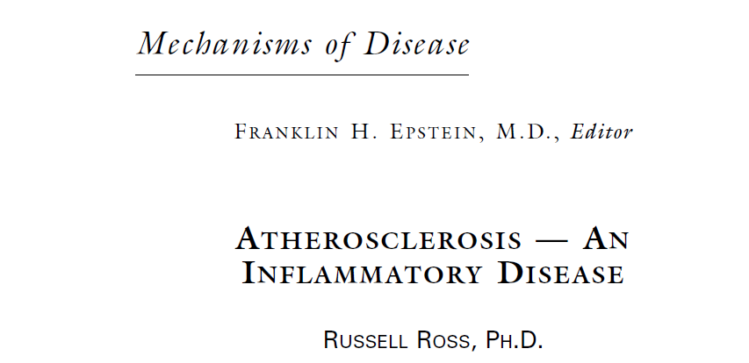

Slide 28
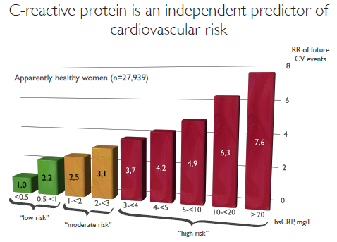
Ridker PM, et al. Circulation 2004

Slide 29
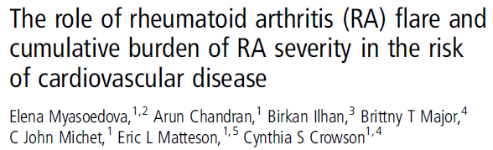
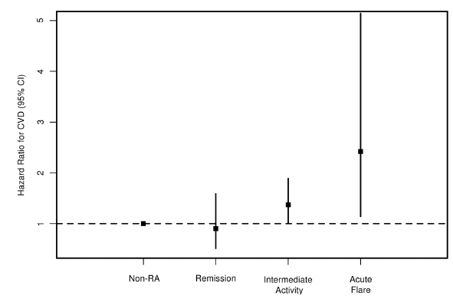
a population-based cohort of
patients with RA without CVD
525 patients with RA
524 non-RA subjects.
adjusted for age, sex, calendar year and CV risk factors

Slide 30
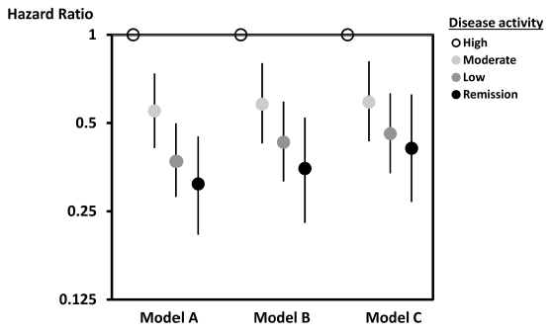


In RA : disease activity and inflammation
Several observational studies have identified associations between higher disease activity in rheumatoid arthritis and cardiovascular outcomes
Acute Coronary Syndrome
CV risk
Risk of CV events
33 % increased CV risk
for 1 unit > DAS28
(time averaged)
Time average in remission associated with a 53 % reduction of risk of CV events vs pts. in HD activity
OR = 1.32 per 1 unit > DAS28
OR = 1.61 for moderate EULAR-DA
2.59 for high EULAR-DA
vs low disease activity
Independently from
traditional CV risk factors (model B)
RA treatment (model C)
Mantel Ä et al. Arthritis Rheumatol 2015
Arts EE et al. Ann Rheum Dis 2015
Solomon DH et al. Arthritis Rheumatol 2015
nested case-control study
Nijmegen early rheumatoid arthritis cohort
CORRONA : 24,989 subjects

Slide 31
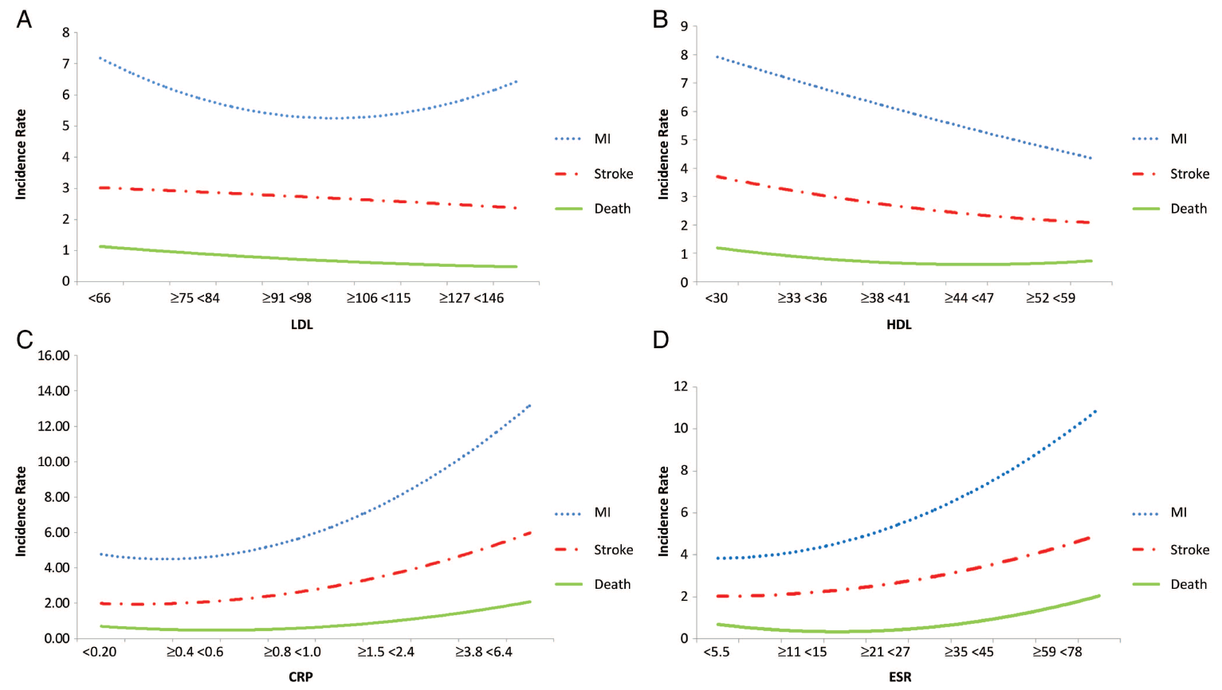
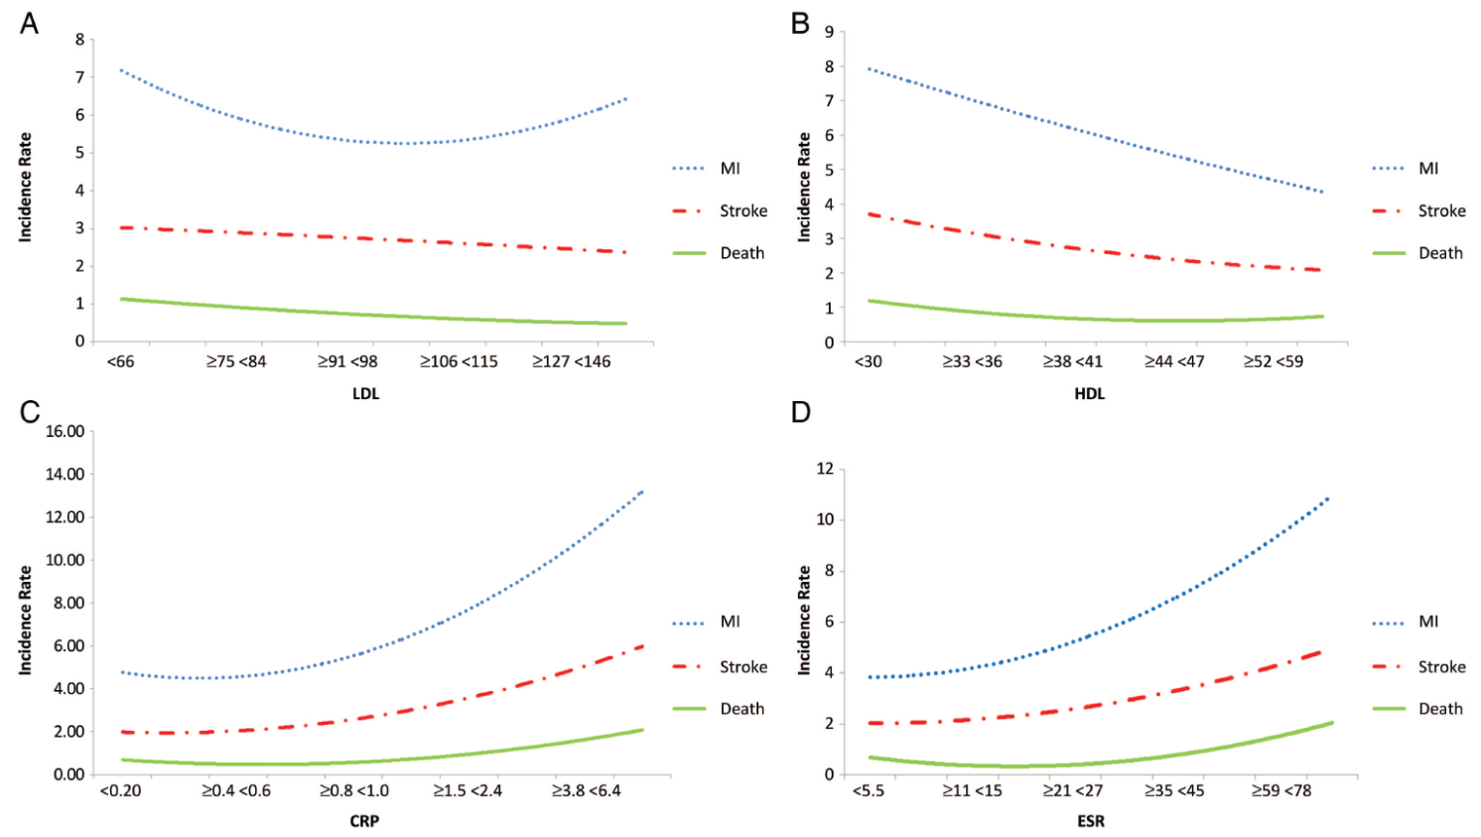
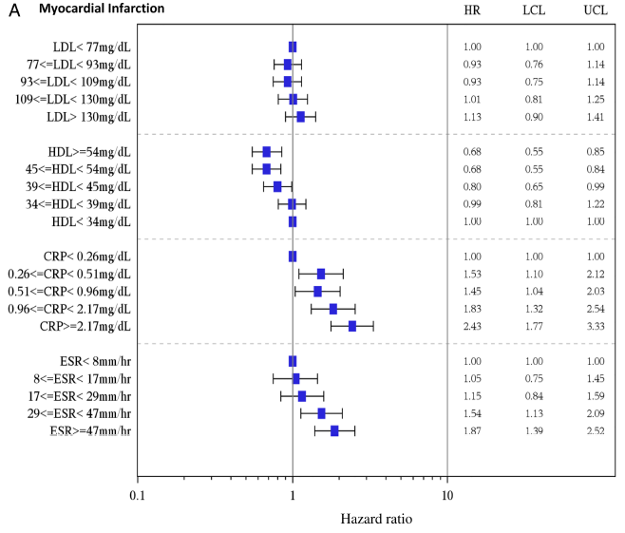
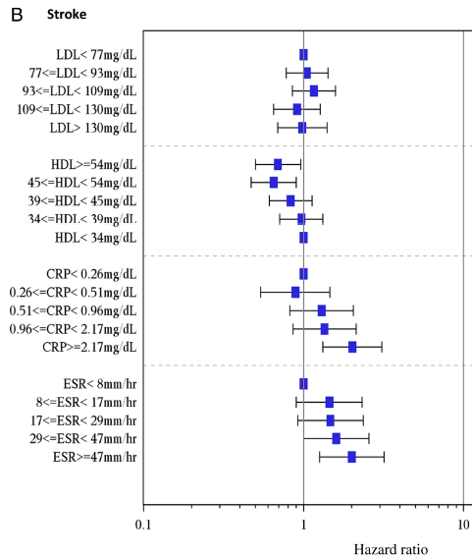
Prominent role of inflammation in CHD risk in RA
National Veterans Health Administration
Navarro-Millán I et al. Ann Rheum Dis 2016
37568 patients with RA in the cohort with mean age of 63 years (SD 12.1);
LDL
HDL
MI
Stroke
CRP
ESR

Slide 32
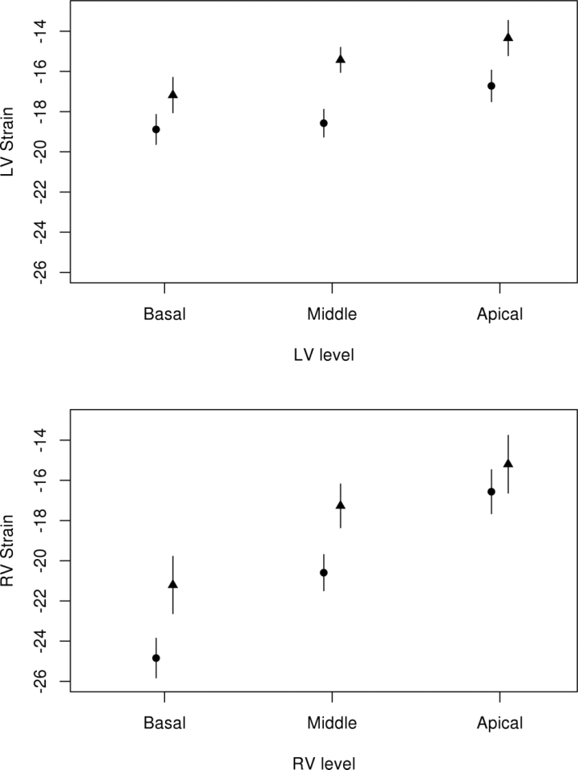
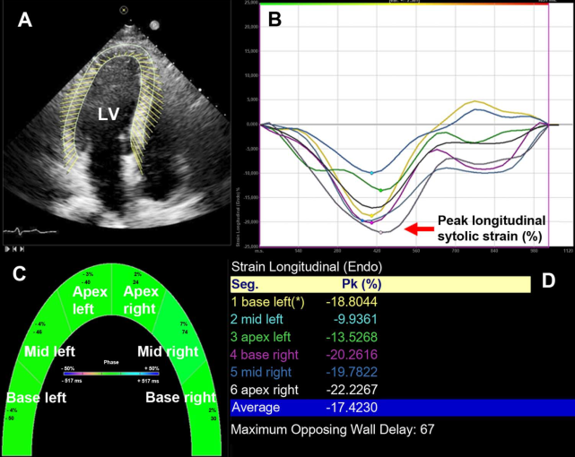
Rheumatoid arthritis disease activity is not only predictive of cardiovascular events but also strongly correlates with cardiac function
Fine NM et al. Ann Rheum Dis 2014
59 patients with RA
59 age, gender, race matched HC
Global longitudinal LV and RV strain is reduced in patients with RA ( ) compared with healthy patients ( )
speckle-tracking echocardiography
Measures myocardial deformation
during contraction and relaxation

Slide 33
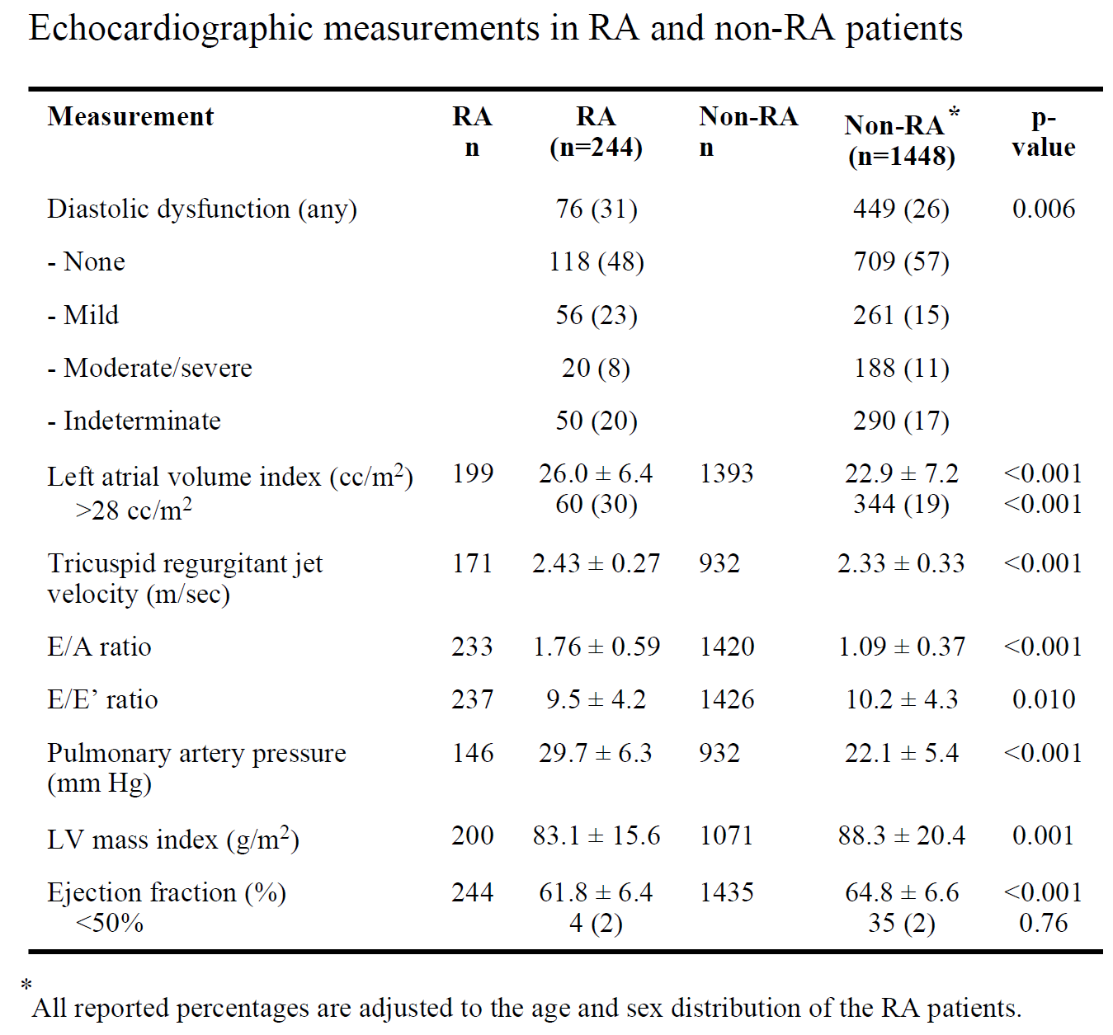
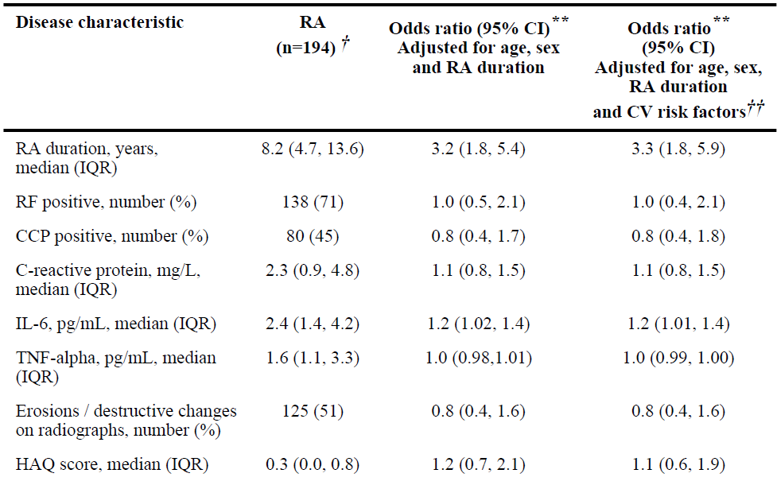
Diastolic dysfunction is also over-represented in rheumatoid arthritis patients and is associated with higher circulating IL-6 concentrations
Liang KP et al. Ann Rheum Dis 2010
Disease characteristics of RA patients and association with diastolic dysfunction

Slide 34
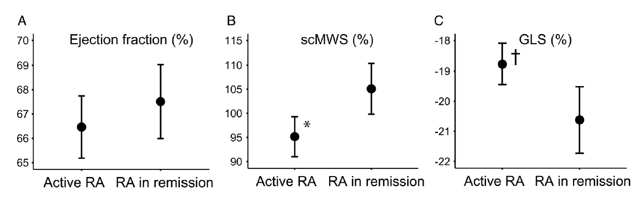
Myocardial function is reduced in patients with RA with active disease compared with patients with RA in remission
Midtbø H et al. Ann Rheum Dis 2017
Patients with RA in remission had similar scMWS and GLS as the controls
*p=0.005 ; †p=0.006
GLS : global longitudinal strain
scMWS : stress-corrected midwall shortening

Slide 35
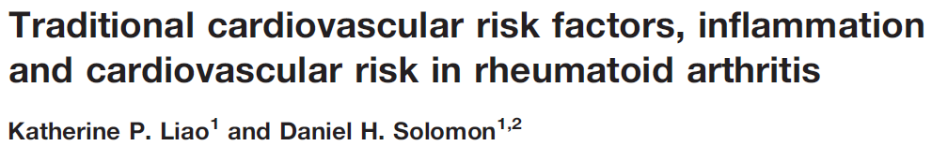
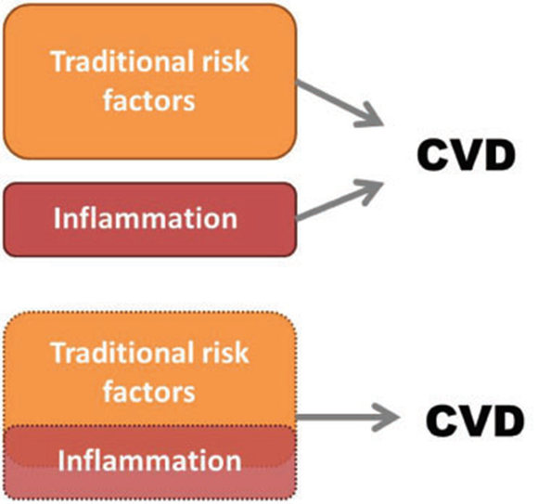

Slide 36
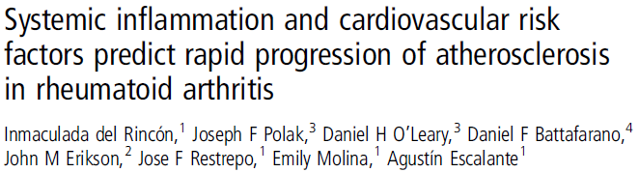
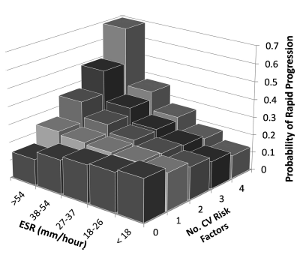
LONGITUDINAL STUDY
631 RA pts. baseline carotid US
After a mean FUP of 2.8 years
487 RA pts. were re-scanned
In the absence of, or with
1 single CV risk factor, the
ESR was not significantly
associated with the IMT progression rate.
With ≥ 2 CV risk factors,
the ESR-IMT progression
rate association grew progressively stronger.
Inflammation and traditional CV-RF have a synergistic effect on progression of IMT

Slide 37
What is the message ?
Disease activity (inflammation) is an important CV risk factor which has a sinergistic effect with traditional CV risk factors contributing to the development of CVD
The associations of disease activity with CV risk and cardiac function impairment in RA patients, prompts attention to target remission as a necessary measure to reduce CV risk and optimally preserve cardiac function.

Slide 38
What about other CIRDs ?

Slide 39
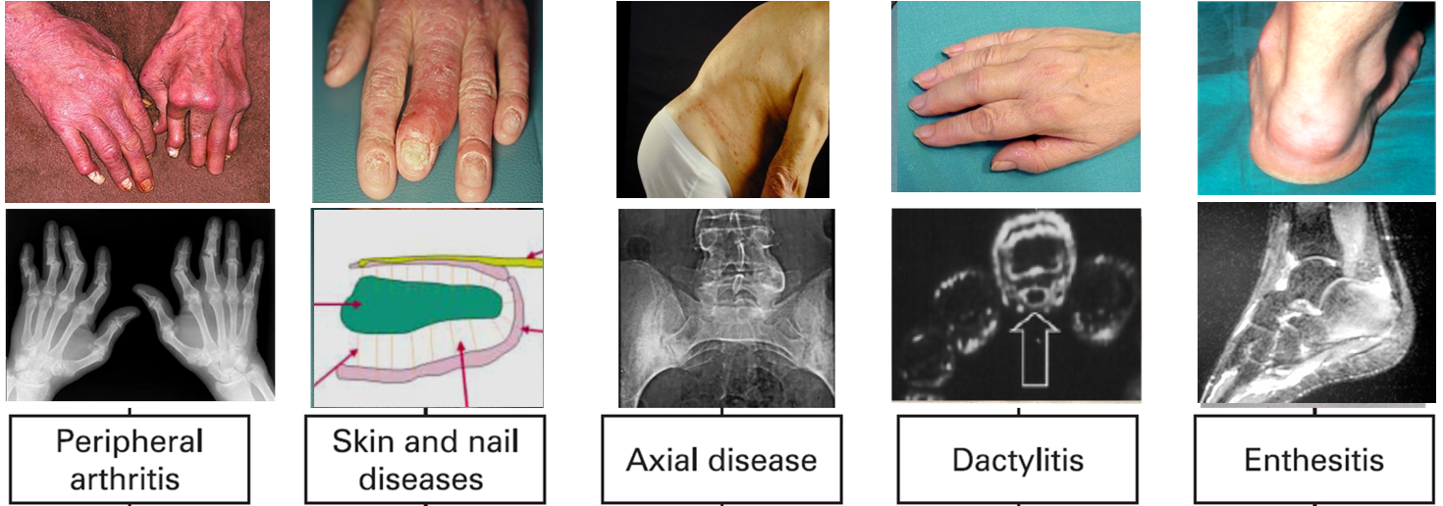
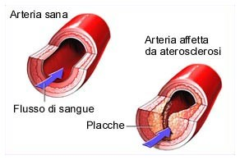
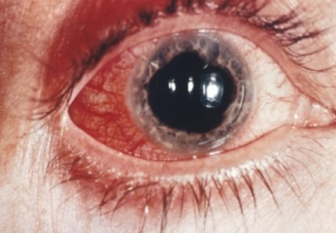

Psoriatic arthritis

Slide 40
CV risk in PsA
Psoriasis ?
Psoriatic
Arthritis ?
Both ?

Slide 41
In psoriasis the prevalence of traditional cardiovascular risk factors is increased
PSORIASIS
Obesity (OR)
Dyslipidemia (OR)
1.80 (95% CI 1.4–2.2)
1.46 (95% CI 1.17–1.82) mild PsO
2.23 (95% CI 1.63–3.05) severe PsO
2.14 (95% CI 1.84 2.48)
1.22 (95% CI 1.11–1.35) mild PsO
1.98 (95% CI 1.62–2.43) severe PsO
Hypertension (OR)
Diabetes (OR)
1.58 (95% CI, 1.42–1.76)
1.30 (95% CI 1.15–1.47) mild PsO
1.49 (95% CI 1.20–1.86) severe PsO
1.76 (95% CI 1.59–1.96)
2.10 (95% CI 1.73–2.55) severe PsO
2.18 (95% CI 1.36–3.50) with arthritis
Smoking (RR)
1.88 (95% CI 1.66–2.13
Puig L et al. Int. J. Mol. Sci. 2018

Slide 42
J Eur Acad Dermatol Venereol. 2013
33 observational studies evaluating the rates of cardiovascular events (CVE) in patients with psoriasis and PsA compared with controls
1980 to 2011

Slide 43


Increased risk of MI in PsO
Horreau C et al. J Eur Acad Dermatol Venereol 2013
cohort studies
OR = 1.25
(95% CI 1.03-1.52)
cross-sectional studies
OR = 1.57
(95% CI 1.08-2.27)

Slide 44


UK General Practice Research Database
1987 - 2002
Gelfand GM et al.
Psoriasis (especially severe psoriasis) is an independent risk factor for myocardial infarction, especially in young patients
127,000 mild PsO
3800 severe PsO
500,000 control
Adj RR of MI in Patients with PsO
RR of Myocardial Infarction
30 year-old
Mild PsO RR = 1.29 (95% CI, 1.14–1.46)
Severe PsO RR = 3.10 (95% CI, 1.98–4.86)
60-year-old
Mild PsO RR = 1.08 (95% CI, 1.03–1.13)
Severe PsO RR = 1.36 (95% CI, 1.13–1.64)

Slide 45



Increased risk of CAD in PsO
Horreau C et al. J Eur Acad Dermatol Venereol 2013
cross-sectional studies
OR = 1.19
(95% CI 1.14-1.24)
cohort studies
OR = 1.20
(95% CI 1.13-1.27)
case–control
OR = 1.84
(95% CI 1.09 - 3.09)

Slide 46


Risk of stroke in PsO
Horreau C et al. J Eur Acad Dermatol Venereol 2013
inconclusive results
cohort studies
OR = 1.02
(95% CI 0.92-1.14)
cross-sectional
studies
OR = 1.14
(95% CI 1.08-1.19)

Slide 47
Summary
The risk of developing CVD is approximately 40% greater in PsO patients
than
in the general population
Severe PsO is associated with a :
58% increased risk of MACE
57% increased risk in CV death
after controlling for traditional cardiovascular risk
Armstrong EJ et al. J Am Heart Assoc. 2013 (SLR and MA)
Miller IM et al. J Am Acad Dermatol. 2013 (MA)
Mehta NN et al. Am J Med. 2011
Mehta NN et al. Eur Heart J. 2010

Slide 48

What is the effect of arthritis on CV risk in PsO patients ?
JEADV 2012
7648 with PsO (without arthritis)
284 with PsA
Population based study (ICD9 codes)
cerebrovascular diseases
cardiovascular diseases
1996 - 2006
HR for incident CVD = 1.82 (95% CI 1.17 - 2.82)
for psoriatic patient with arthritis vs PsO without arthritis (as reference)
Methotrexate prescription was associated with reduced risk for developing cerebrovascular disease
(HR = 0.45 (95% CI 0.23 - 0.85)

Slide 49

Psoriatic arthritis
Multivariate Cox-Proportional Hazards Model of Developing New Comorbidity After Index Date
Higher Incidence rates of CV-related comorbidities and CV risk factors in patients with PsA compared with the GP Using U.S. Administrative Claims Data
Kaine J et al. JMCP 2019

Slide 50



Cross sectional study
611 patients with PsA (psoriatic arthritis)
449 psoriasis without arthritis
University of Toronto

Slide 51



Cross sectional study
Mean FUP 2.5-3 years

Slide 52


Cross sectional study
CV and metabolic comorbidities are increased in patients with PsA compared with non-PsA SpA, irrespective of demographic factors and type of treatment

Slide 53



OR = 1.43 (95% CI 1.24 - 1.66)

Slide 54
Polachek A et al. Arthritis Rheumatol 2017
OR = 1.68 (95% CI 1.31 - 2.15)
OR = 1.22 (95% CI 1.05 - 1.41)
OR = 1.32 (95% CI 1.11 - 1.57)

Slide 55
Summary
Higher prevalence of metabolic syndrome and CV risk factors in PsA
The risk of developing CVD is approximately 43% greater in PsA patients
than
in the general population
In PsA increased risk of
Myocardial infarction 68 %
Stroke 22 %
Heart failure 31%

Slide 56








AS n = 6448
PsA n = 16,063
uSpA n = 5190
GP n = 266,435
Swedish National Patient and Population registers 2001–2009
AS, PsA, uSpA

Slide 57
Systemic Lupus Erythematosus

Slide 58
Survival rates in systemic lupus erythematosus (SLE) have improved over the last 6 decades
FDA approval of antimalarials and corticosteroids
1948–1955¹
Standardized Mortality Ratio
90 %
2.4 Bernatsky S et al.
Arthritis Rheum 2006
4.6 Lopez R et al.
Rheumatology 2012
7.9 Mok CC et al.
J Rheumatol 2008
(Chinese hospital-based)
12.6 Urowitz MB et al.
J Rheumatol 2008
(Canadian cohort)
80 %
Estimated survival of patients (%)
* Values are the average of survival data from multiple study summaries.
1. Borchers AT, et al. Autoimmun Rev 2004; 3:423–453; 2. ACR Ad Hoc Committee on SLE Guidelines. Arthritis Rheum 1999; 42:1785–1796; 3. Hay E. Ann Rheum Dis 1993; 52:169–172; 4. Bertsias G, et al. Ann Rheum Dis 2008; 67:195–205.
Notes:
Advances made in the diagnosis and treatment of SLE over the last 60 years^{1–3}
BUILD 1 & 2: Discovery of the LE cell in the late 1940s was rapidly followed by a range of therapies (antimalarials, corticosteroids and, later, immunosuppressive agents), with an immediate impact on patients’ life expectancy.¹
BUILD 3: The development of new laboratory testing procedures improved the diagnostic process.²
BUILD 4: Clinical experience led to improvements in treatment and, over the decades, guidelines were developed.³
BUILD 5: Attempts to assess treatment efficacy led to the development of multiple disease assessment tools.⁴
These tools are particularly important for the assessment of treatment efficacy in clinical trials.
The number of tools developed, each with different strengths and limitations, reflects the challenges faced in the assessment of such a diverse and complex disease.
References
Borchers AT, et al. Surviving the butterfly and the wolf: mortality trends in systemic lupus erythematosus. Autoimmun Rev 2004; 3:423–453.
Bertsias G, et al. EULAR recommendations for the management of systemic lupus erythematosus. Report of a Task Force of the EULAR Standing Committee for International Clinical Studies Including Therapeutics. Ann Rheum Dis 2008; 67:195–205.
ACR Ad Hoc Committee on Systemic Lupus Erythematosus Guidelines. Guidelines for referral and management of systemic lupus erythematosus in adults. Arthritis Rheum 1999; 42:1785–1796.
Hay E. Assessment of lupus: where are we now? Ann Rheum Dis 1993; 52:169–172.

Slide 59

Nossent J et al. Lupus 2007
Increased risk of death from atherosclerotic CVD
Cause of death
In SLE
(Europe)
Overall risk in SLE: 2 - 3-fold increase in CV events in SLE patients
Schoenfeld SR et al. Semin Arthritis Rheum 2013
in women aged 35 - 44 years with SLE the risk of MI is 50-fold that of the age and sex-matched general population
Manzi S et al. Am J Epidemiol 1997

Slide 60

Traditional CVD risk factors in SLE
Giannelou M, Mavragani. CP J Autoimmunity 2017

Slide 61


Disease related contributors of atherosclerosis in SLE
Imbalance between atherogenic insults and atheroprotective mechanisms in lupus related atherosclerosis.
Giannelou M, Mavragani. CP J Autoimmunity 2017

Slide 62


The main risk factor for mortality in SLE is organ damage, which in turn is driven by disease activity and drug-related effects
Rahman P et al. Lupus 2001
Alarcón GS et al. Rheumatology 2004
Mak A et al. Nat Rev Rheumatol 2013
Nived O et al. J Rheumatol 2002
Uribe AG et al. Autoimmun Rev 2004
Nossent J et al. Lupus 2010
Doria A et al. Autoimmun Review 2014
Accrual of organ damage over time in patients with SLE
Gladman DD et al.
J Rheumatol 2003

Slide 64


Increase CV risk

Slide 65

Roubille C et al ARD 2015
Increase CV risk

Slide 66
Cardiovascular effects of hydroxychloroquine
Mathieu S et al. Ann Rheum Dis 2018
SLR and meta-analysis
decrease CV risk
Patients with RA and systemic connective diseases assuming HCQ are characterized by a significant reduction of CV events in comparison to non-HCQ users
Has a favorable effect on lipids
Reduces insulin resistance
Decreases the risk of thrombosis
HCQ users* (n = 1211)
78 CVE
6.4 %
RR = - 0.25 (95% CI -0.52 to 0.02)
HCQ non-users (n = 1074)
238 CVE
22.1 %
*SLE and RA
CVE : cardiovascular events

Slide 67

Roubille C et al ARD 2015
decrease CV risk

Slide 68

Roubille C et al ARD 2015
decrease CV risk

Slide 69


Slide 70
Issues to be covered for a strategy to prevent CVD in CIRDs
4. Which strategies to prevent CV risk in CIRDs ?
Which information should be collected ?
How to assess CV risk in CIRDs and how frequently ?
What should be done to reduce CV risk in CIRDs ?

Slide 71

A. Which information should be collected ?
EULAR task force
et al.
[LoE] & (LoA)
HISTORY OF PREVIOUS CVD
History of myocardial infarction, pectoris angina, stent, stroke, transient ischaemic attack, heart failure and lower limb peripheral arterial disease should be documented. [5] (9.7)
ASSESS CV RISK FACTORS
Cardiovascular risk factors such as smoking status, body mass index, history of hypertension, hypercholesterolaemia, renal insufficiency and HEART-SCORE index should be documented. [1b] (9.5)
ASSESS CURRENT CV TREATMENT
Current cardiovascular treatments such as antihypertensive therapy, antiplatelet therapy, diabetes insulin or non-insulin therapies, lipid-lowering agents and anticoagulants should be documented. [5] (9.6)

Slide 72
B. How and When to assess CV risk in CIRDs ?
Baillet A et al. ARD 2016
Rheumatoid arthritis (also AS, PsA)
[LoE] & (LoA)
Assess CV risk at least every 5 years
Use SCORE CVD risk prediction model but x 1.5
[3-4] C (8.8)
Assess TC and HDLc*
[3-4] C-D (8.7)
[3] C (8.8 )
use carotid ultrasound
[3-4] C (7.5)
*When disease activity is stable or in remission
TC/HDL is better
[3-4] C-D (5.7)

Slide 73


SCORE – EUROPEAN HIGH RISK CHART
10 year risk of fatal CVD in high risk regions of Europe
Austria, Belgium, Denmark, Finland, F, Germany, Greece, Iceland, Ireland, Italy, Luxembourg, NL, Norway, Portugal, Slovenia, Spain, Sweden, CH, UK

Slide 74
C. What should be done to reduce CV risk in CIRDs ?
REDUCE
CONTROL
BE CAREFUL
& USE APPROPRIATELY

Slide 75

et al.
Optimal disease activity control
[LoE] SoR (LoA)
Anti
hypertensives and statins as in GP
Lifestyle advises
(diet, exercise, smoke)
[2b-3] B (9.1)
[3-4] C-D (9.2)
[3] C (9.8)
Be cautious in prescribing NSAIDs
Use GC at low dosages and try to taper
[2a-3] C (8.9)
[3-4] C (9.5)

Slide 76


Slide 77
Does all this work ?

Slide 78



In CIRDs, RCTs of disease-modifying anti-rheumatic drugs (DMARDs), and biologic anti-cytokine therapies have not been powered to detect the impact of these agents on the modification of subclinical atherosclerosis and CV disease risk.
The actual effect of anti-rheumatic therapies on atherosclerosis progression and CV outcome in these patients is rather uncertain due to great literature inconsistency.

Slide 79




T2T strategy in CIRDs
et al.
et al.
et al.
et al.

Slide 80



T2T …
et al.

Slide 81

Survival rates in systemic lupus erythematosus (SLE) have improved over the last 6 decades … but still sub-optimal
Causes of death :
  CVA
  Infections
  Malignancies
* Values are the average of survival data from multiple study summaries.
1. Borchers AT, et al. Autoimmun Rev 2004; 3:423–453; 2. ACR Ad Hoc Committee on SLE Guidelines. Arthritis Rheum 1999; 42:1785–1796; 3. Hay E. Ann Rheum Dis 1993; 52:169–172; 4. Bertsias G, et al. Ann Rheum Dis 2008; 67:195–205.
Notes:
Advances made in the diagnosis and treatment of SLE over the last 60 years^{1–3}
BUILD 1 & 2: Discovery of the LE cell in the late 1940s was rapidly followed by a range of therapies (antimalarials, corticosteroids and, later, immunosuppressive agents), with an immediate impact on patients’ life expectancy.¹
BUILD 3: The development of new laboratory testing procedures improved the diagnostic process.²
BUILD 4: Clinical experience led to improvements in treatment and, over the decades, guidelines were developed.³
BUILD 5: Attempts to assess treatment efficacy led to the development of multiple disease assessment tools.⁴
These tools are particularly important for the assessment of treatment efficacy in clinical trials.
The number of tools developed, each with different strengths and limitations, reflects the challenges faced in the assessment of such a diverse and complex disease.
References
Borchers AT, et al. Surviving the butterfly and the wolf: mortality trends in systemic lupus erythematosus. Autoimmun Rev 2004; 3:423–453.
Bertsias G, et al. EULAR recommendations for the management of systemic lupus erythematosus. Report of a Task Force of the EULAR Standing Committee for International Clinical Studies Including Therapeutics. Ann Rheum Dis 2008; 67:195–205.
ACR Ad Hoc Committee on Systemic Lupus Erythematosus Guidelines. Guidelines for referral and management of systemic lupus erythematosus in adults. Arthritis Rheum 1999; 42:1785–1796.
Hay E. Assessment of lupus: where are we now? Ann Rheum Dis 1993; 52:169–172.

Slide 82



but still sub-optimal

Slide 83


A population-based nationwide cohort study in Sweden
but still sub-optimal
Deaths attributed to CVD decreased
survival
GP
Despite a decreasing absolute mortality rate, the excess risk of mortality in RA compared with the general population remains
RA

Slide 84


EFFECT OF A TREAT-TO-TARGET INTERVENTION OF CARDIOVASCULAR RISK FACTORS ON SUBCLINICAL AND CLINICAL ATHEROSCLEROSIS IN RA: A RCT
Benjamin Burggraaf et al. July 2018 Rheumatoid Arthritis
320 RA patients without prior CVD or diabetes mellitus were randomised 1:1 to either a treat-to-target approach or usual care of traditional CVD risk factors.
cIMT for the usual care (●) and treat-to-target intervention group during 5 years of follow-up
CVE and cardiovascular and all-cause mortality according to treatment groups after 5 years of FUP
p = 0.028
Notes:
Background Patients with rheumatoid arthritis (RA) have an increased risk for cardiovascular disease (CVD).
No long-term intervention trials on CVD risk factors have been published, and a debate on the efficacy of
controlling traditional risk factors in RA is ongoing. We aimed to evaluate a treat-to-target approach versus
usual care regarding traditional CVD risk factors in patients with RA.
Methods I n this open-label, randomised controlled trial, patients with RA aged <70 years without prior CVD
or diabetes mellitus were randomised 1:1 to either a treat-to-target approach or usual care of traditional CVD
risk factors. The primary outcome was defined as change in carotid intima media thickness (cIMT) over 5 years,
and the secondary outcome was a composite of first occurrence of fatal and non-fatal cardiovascular events.
Results A total of 320 patients (mean age 52.4 years; 69.7% female) with RA underwent randomisation and
219 patients (68.4%) completed 5 years of follow-up. The mean cIMT progression was significantly reduced
in the treat-to-target group compared with usual care (0.023 [95% CI 0.011 to 0.036] mm vs 0.045 [95% CI
0.030 to 0.059] mm; p=0.028). Cardiovascular events occurred in 2 (1.3%) of the patients in the treat-totarget
group vs 7 (4.7%) in those receiving usual care (p=0.048 by log-rank test).
Conclusion This study provides evidence on the benefit of a treat-to-target approach of traditional CVD risk
factors for primary prevention in patients with welltreated RA.

Slide 85



720 consecutive RA pts
mean age 59 years
*
cholesterol-lowering or
antihypertensive drugs

Slide 86
Summary
In CIRDs, CV risk and related mortality are increased in comparison with GP
Current models tend to underestimate the CV risk in CIRDs
In CIRDs, traditional CV risk factors and inflammation interact in a complex way
To reduce CV risk in CIRDs, both inflammation and traditional risk factors should be checked according to a T2T strategy
Although in recent years some studies have shown a decreased CV mortality in RA and other CIRDs, strategies to prevent CVD need to be implemented
A more strict collaboration between Rheumatologist, GP and Cardiologist is advisable

